Slide 1

ICT Learning Centre @ UL - Python and ML Foundations
Python – I/O

Slide 2



Input/Output
Interacting with users and files

Slide 3
Types of basic I/O
Python Input
Python Output
User Input
File Read
print()
File Write

Slide 4

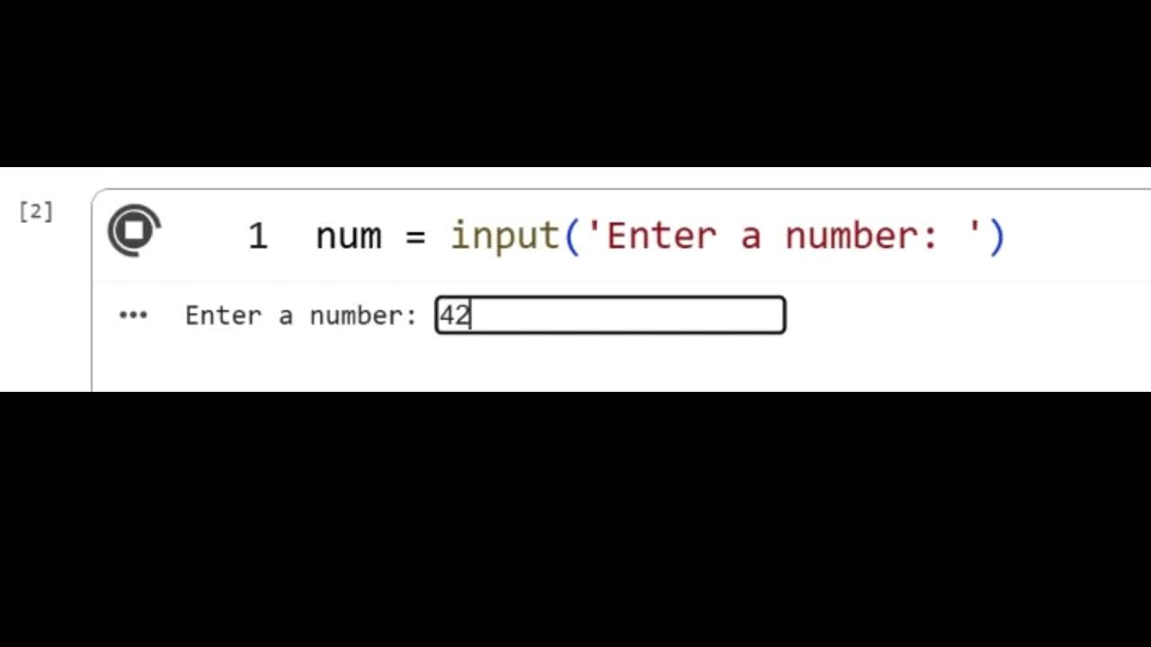
User input
Example:
user_input = input(‘Enter your name: ’)
Note:
- Default input return type -> string.
- Other data types need to be ‘typecast’.

Slide 5
Typecasting
Example:
user_input = input(‘Enter a number: ’) # input string → ‘42’
num = int(user_input) # Now int → 42
float()
bool()
str()

Slide 6
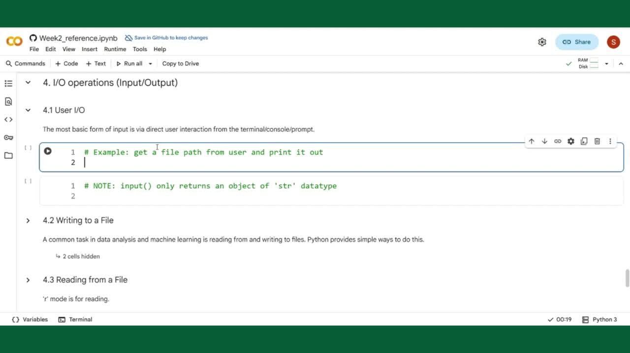

Slide 9
Why use file I/O?
Program’s memory is temporary.
File I/O lets you:
Save results.
Read data from external sources (like datasets!).
Load configurations.

Slide 10
Best Practice: with Statement
Automatically closes files for you, even if errors occur.
Modern, safe way to handle files in Python
Syntax:
with open(‘filename.extension’, ‘mode’) as f:
text = f.read() # Use read() to read contents in file.

Slide 11
File operation modes
‘r’
Read (Default mode): Throws an error if the file doesn't exist.
‘r’
Read (Default mode): Throws an error if the file doesn't exist.
‘w’
Write: Creates a new file (or overwrites an existing one).
‘a’
Append: Adds content to the end of an existing file.

Slide 12
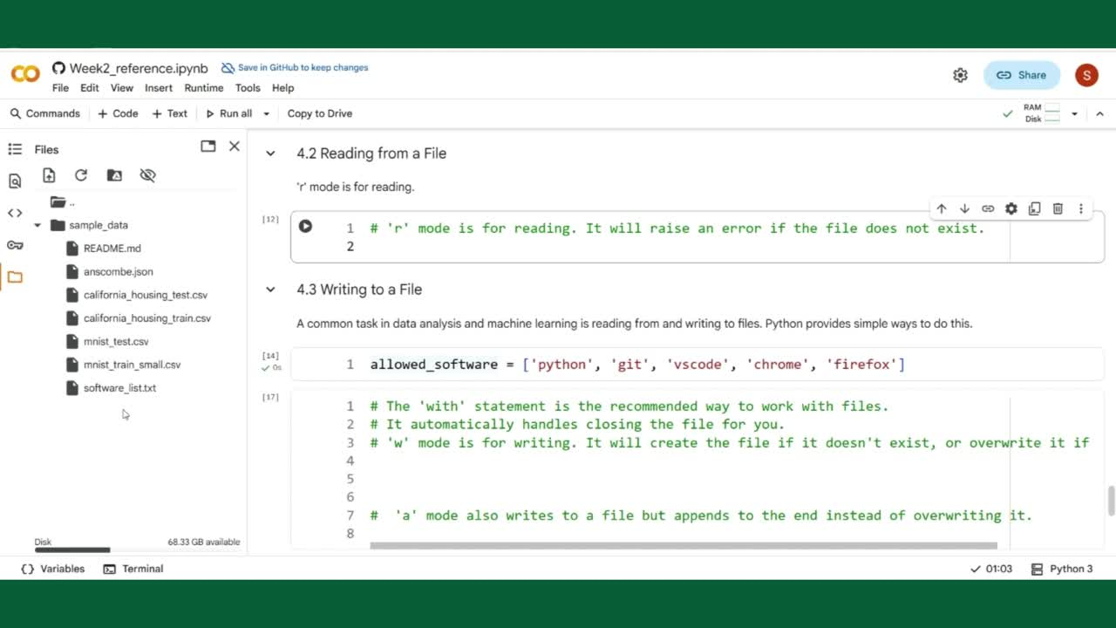

Slide 15
File operation modes
‘r’
Read (Default mode): Throws an error if the file doesn't exist.
‘w’
Write: Creates a new file (or overwrites an existing one).
‘a’
Append: Adds content to the end of an existing file.

Slide 19
File operation modes
‘r’
Read (Default mode): Throws an error if the file doesn't exist.
‘w’
Write: Creates a new file (or overwrites an existing one).
‘a’
Append: Adds content to the end of an existing file.
‘a’
Append: Adds content to the end of an existing file.

Slide 22


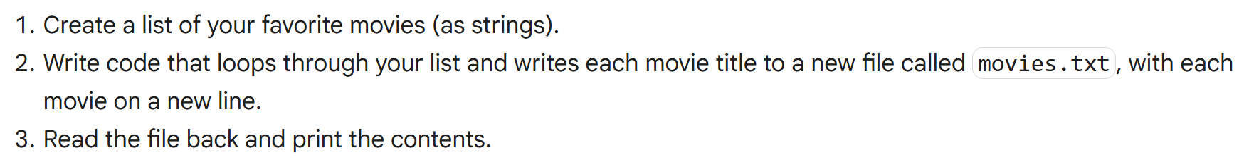
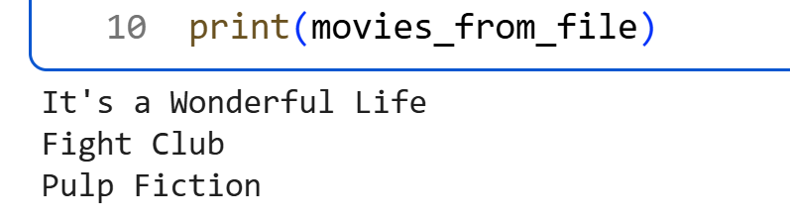

Practice Question
Python is cool :)
Expected Output

Slide 23

ICT Learning Centre,
CS1-046,
CSIS Building,
University of Limerick,
http://ictlc.ul.ie/contactus
Thank you

